Slide 1
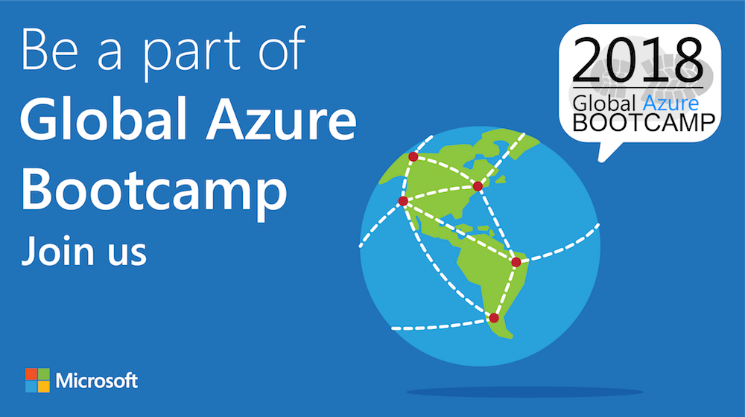

Slide 2

Welcome to the
{Curitiba - PR}

Slide 3

Sponsors & Prices

Slide 4








A BIG thank you to the 2018 Global Sponsors!

Slide 5


Another BIG thank you to local sponsors!

Slide 6


All attendees get the following:
Sponsor | Offering
Cloudmonix https://cloudmonix.com | Cloudmonix offers a $300 off any paid plan for Azure monitoring! http://bit.ly/gab2018-cloudmonix Code: GAB2018
MyGet https://myget.org | MyGet offers a free 1 month Starter Plan for hosting your NuGet, npm, Maven, Bower of VSIX feeds! http://bit.ly/gab2018-myget Code: GGAB2018-MG
ServiceBus360 https://servicebus360.com | Servicebus360 is offering 2 months free of their Gold Plan! http://bit.ly/gab2018-sb360
Cerebrata https://cerebrata.com | Cerebrata is providing a 3 month subscription to it’s Cerulean product! Get your subscription key from your organizer!
Offers valid until April 30th

Slide 7


Raffle Prizes
1 Winner: a 1 year personal subscription of the All Products Pack. Get all desktop products including IntelliJ IDEA Ultimate, ReSharper Ultimate and other IDEs
1 Winner: a 1 year subscription to Cerulean! A cross-platform Azure management tool for storage, CosmosDB, Search, Redis Cache and Service Bus.
1 Winner: a 1 year subscription to their online training, Skill Me Up! Online training to continue your Azure journey.
Raffle winners will receive a voucher with a code from the local organizers.

Slide 8

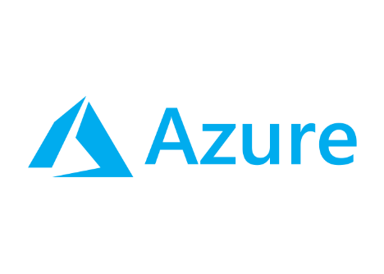
Soluções de balanceamento de carga no Azure
Fernando Henrique da Silva
MTAC, MCT, MCSE
WIPRO
Curitiba

Slide 9



Sumário
Azure Load Balancer
Application Gateway
Traffic Manager

Slide 10
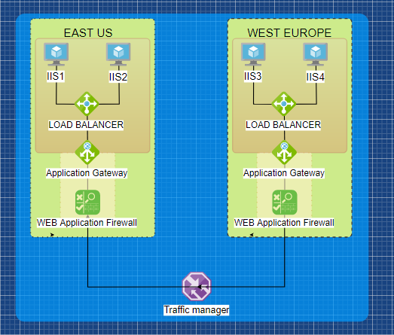


Slide 11
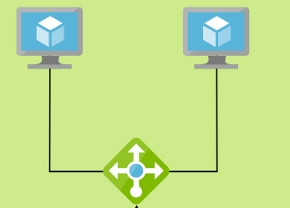
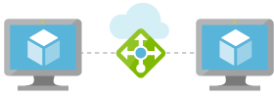
Azure Load Balancer
Público ou Interno
Suporte a IPv6
Atua na camada de transporte do modelo TCP
Balanceamento exclusivo para VMs
Suporte a NAT para encaminhamento de portas
Notes:
https://docs.microsoft.com/en-us/azure/load-balancer/load-balancer-overview

Slide 12
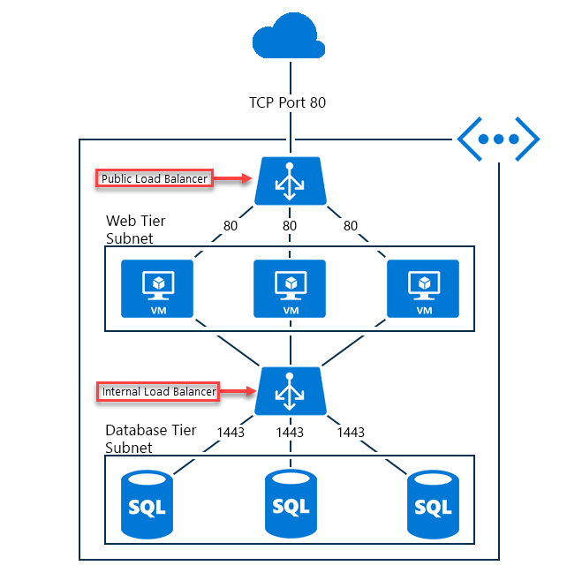
DEMO
Utilizar Availability Set para balanceamento entre mais de 1 VM
Modelos Basic e Standard tem recursos e preços diferenciados
Load balance interno para SQL

Slide 13
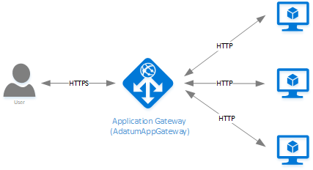
Azure Application Gateway
Controlador de entrega de aplicativos (ADC) como serviço
Suporte a recursos da camada de aplicação TCP
Suporte ao processameto TLS / SSL Offload, otimizando a performance da aplicação
Roteamento com base na camada 7, ex. Roteamento com base na URL e cookies.
Suporte a Web Application Firewall (WAF)
Notes:
https://docs.microsoft.com/pt-br/azure/application-gateway/application-gateway-introduction

Slide 14
WEB Application Firewall
Proteção centralizada contra ataques, sem necessidade de customizar o backend
Proteção baseada no conjunto de regras se segurança OWASP 3.0 ou 2.2.9
Oferece suporte a dois modos de execução:
Detection – Ameaças são registradas em um arquivo de log, que pode ser integrado aos recursos de análise de logs do Azure Prevention – Bloqueia possíveis ameaças, retornando ao possivel hacker o erro 403 – Unauthorized Access Exception.
Notes:
https://docs.microsoft.com/en-us/azure/application-gateway/application-gateway-web-application-firewall-overview
https://www.owasp.org/index.php/Category:OWASP_ModSecurity_Core_Rule_Set_Project

Slide 15
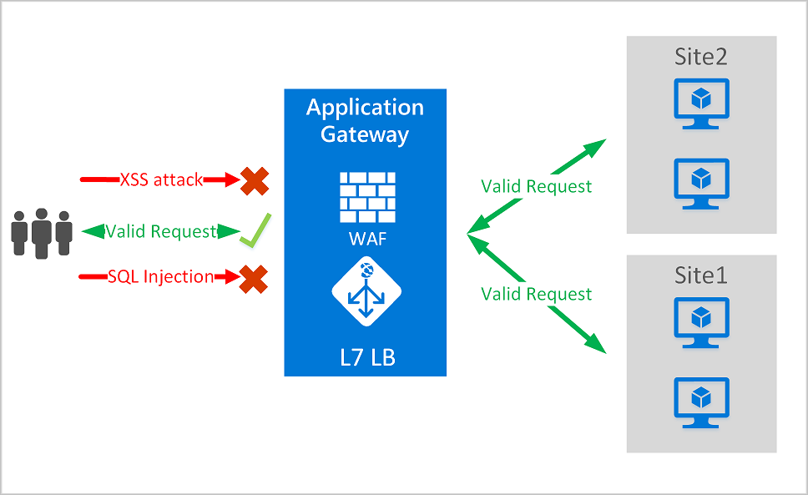

Slide 16
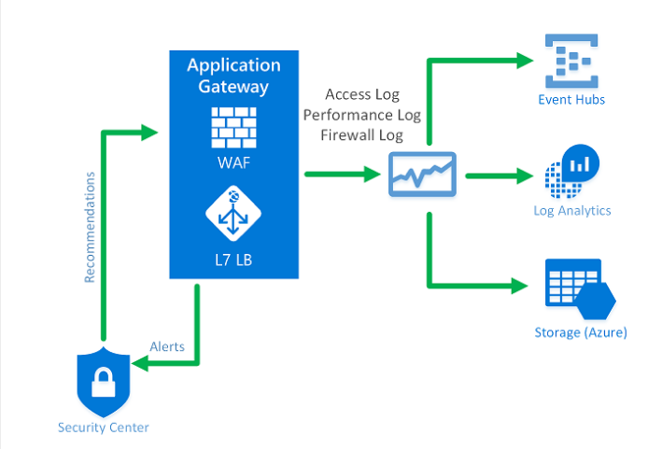

Slide 17

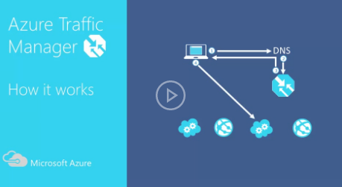
Traffic Manager
Direciona o tráfego de entrada de Serviços/Apps para endereços DNS diferentes, com base no método de roteamento definido.
Combinar aplicativos baseados em nuvem e locais
Notes:
https://docs.microsoft.com/en-us/azure/load-balancer/load-balancer-overview

Slide 18
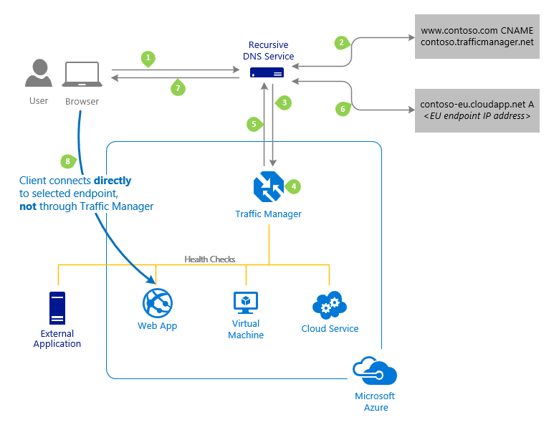

Slide 19
Demo + Hands-On

Slide 20

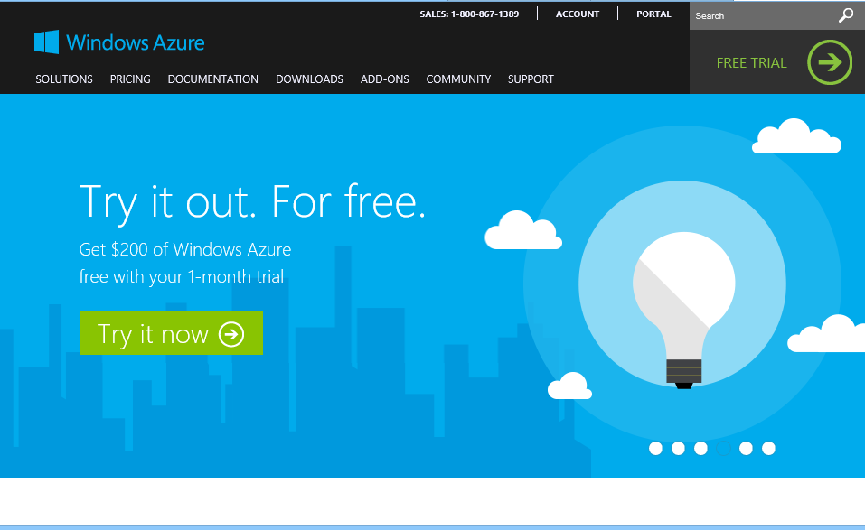
Comece agora.
http://WindowsAzure.com

Slide 21
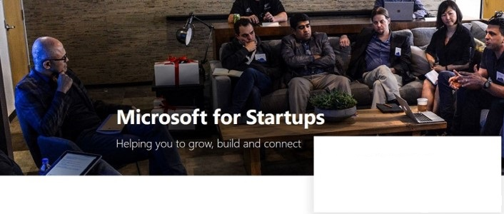

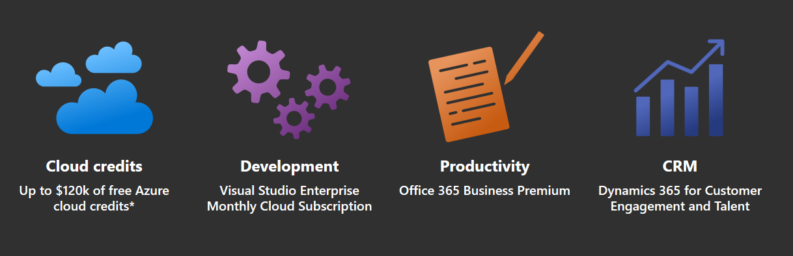
Microsoft 4 Startups
https://startups.microsoft.com
Notes:
Microsoft for Startup é o substituto do antigo “Microsoft BizSpark”.

